Slide 1

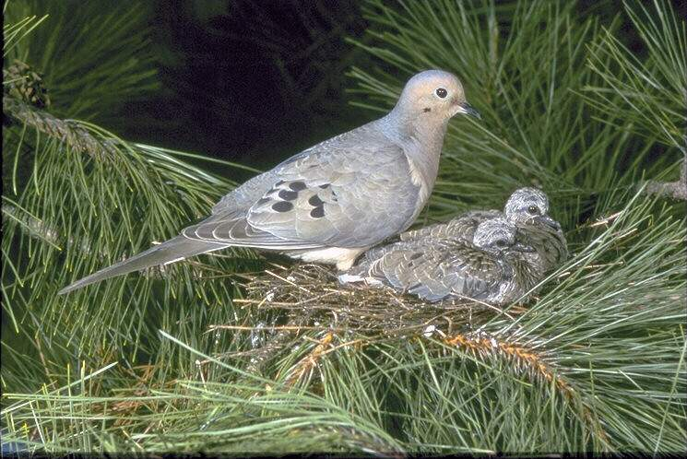
WELCOME TO OUR ENGLISH CLASS

Slide 2
Presented by
Md.Delwar Hossain
Assistent Teacher,
Gopal pur Dr.Mosharraf Hossan High School,Titas,Comilla
Mobiel-01818-832782
Email-delwarsir123gmai.com

Slide 3

Class: six
Subject: English Second Paper

Slide 4
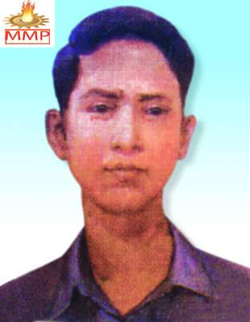

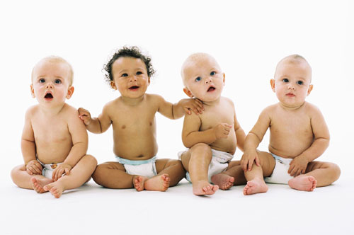

man
woman
Children
box

Slide 5
So to day we Will Learn about -
GENDER,

Slide 6
Objectives:
By The End Of The Lesson:
Ss can tell the definition of Gender.
Ss can classify Gender.
Ss can use Gender in sentences.

Slide 7
Classification Of Gender
GENDER
Masculine
Feminine
Common
Neuter

Slide 8

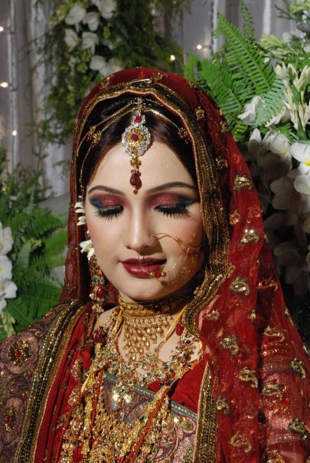
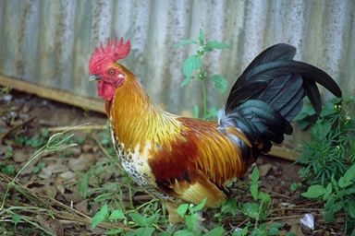
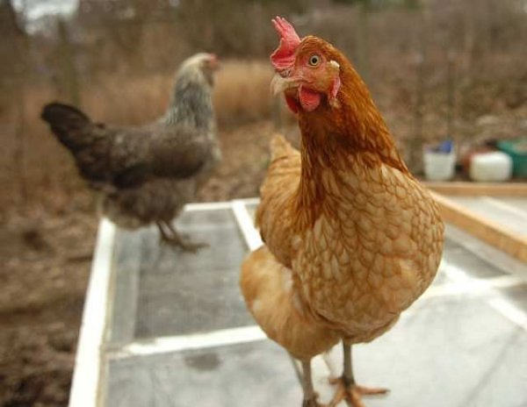
Gender
Bridegroom
Bride
Hen
Cock

Slide 9
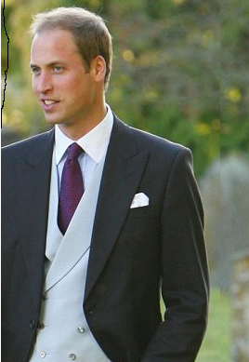
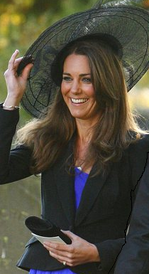
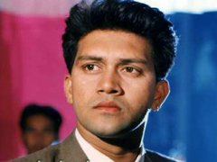

By adding ‘ess’ at the end of the word
prince
Princess
Actor
Actress

Slide 10
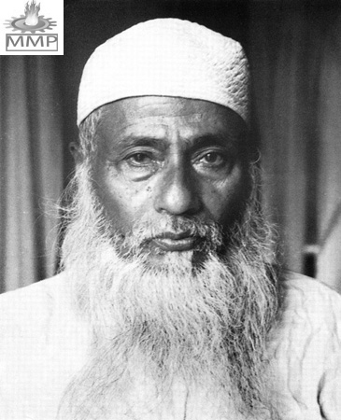
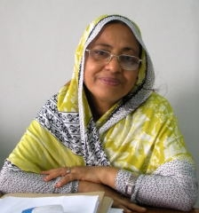
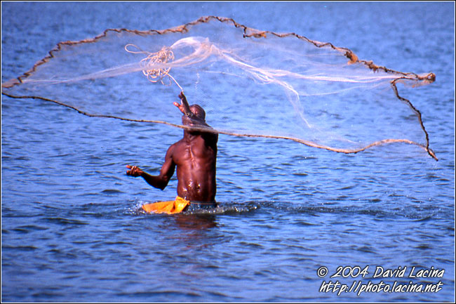
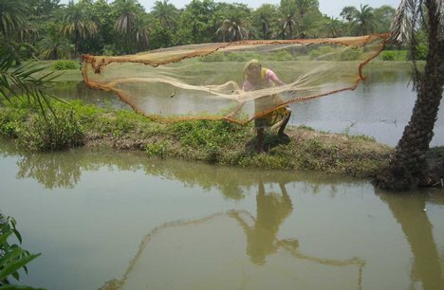
By using Feminine part of Masculine in Compound Noun
Father-in-law
Mother-in -law
  Fisherman
Fisherwoman

Slide 11

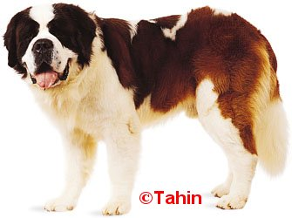
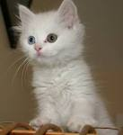
Common Gender
puppy
Child
kitten

Slide 12
Individual work
3 minutes
Meaning of Gender

Slide 13
Group Work
5 minutes
Fill in the blanks with appropriate Gender given in the box:
Hen ,waiter, emperor, bride, actor
Shajahan was an----------------------
The ----------------reached the party late.
The----------------has laid an egg.
Shakil kan is a famous --------------------.
Halim is a --------------in a hotel.

Slide 14
FEMININE FROM MASCULINE
We can change Feminine from Masculine in three ways.
By using different words
    BY adding ‘ess’ at the end of the word
BY using feminine part of masculine in compound Noun.

Slide 15
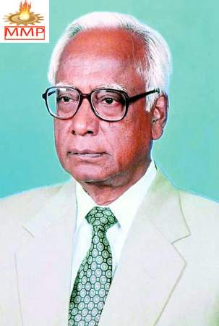
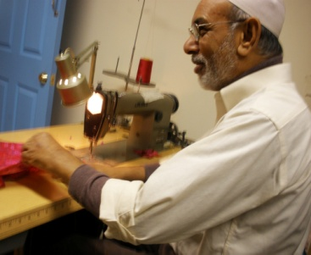

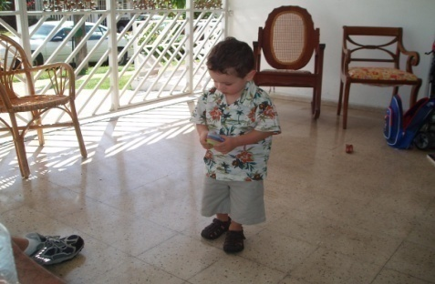
Evaluation
He was the --of Bangladesh
The man is a ------------.
.
This is a ---------.
This is a ---------.

Slide 16
Home Work
ten Write sentences using Gender.

Slide 17

THANKS
TO
EVRY BODY

